Slide 1

Change Management GUIDE
Add-on Sale - SDOD
Change Requests – CR GC
&
Change Control board - CCB
Ranu Moodley
Business Operations / Q&OE
2019/01

Slide 2
Change Management Networks & DGS
To ensure that Add-on Sales or Change requests are processed in a structured, controlled, timely and professional manner within a Change Control board.
SDOD
Add-on Sale & Opportunity
Change Control Board
Global Chronos Change Request
Lead generation BNEW
Qualified AoS from SDOD tool
CR analysis & submission
Handed over to SalesForce & GC tool
SDOD tool
*CCB
Create CR
CCB quality audit
CCB review & decisions
Qualified by ACR/KAM
CPM
Update status
In GC
Add-on Sale
New Opportunities
Add Status, Financials & Schedule
CR Execution
Propose CR to customer & negotiate
Add approval CCB Steering or Project flow
Prequalification by Lead handlers
CR Final Decision

Slide 3





Purpose of Change Management Networks & DGS
Clearer Contract Management with customer From initial deal through project delivery to contract closure
Improve Visibility Change Requests enforced for all significant changes
Clearer financial tracking & ensuring positive contribution to margin
Increased Governance Change Control Board (CCB) mandatory for all projects
No changes without advance formal approval
Better
Service Delivery Opportunity Database
Global Chronos
Change Control Board
Better Configuration Management All changes identified & tracked
One tool for tracking changes (Global Chronos)
Encourage AoS creation SDOD to capture all AoS & Sales Ideas from all delivery resources

Slide 4
The SDOD3.0 guide
Lead generation BNEW
Handed over to SalesForce & GC tool
SDOD tool
Qualified by ACR/KAM
CPM
Add-on Sale
New Opportunities
Prequalification by Lead handlers

Slide 5




Encourage AoS creation Sales Opportunity Generation (SOG) and Add on Sales (AoS) are two of the global BLG (Business Lead Generation) processes in Ericsson that leverage on employees’ contribution to business generation and are key for the Company’s growth and profitability.
SDOD
Add-on Sale & New Opportunity
SOG, Sales Opportunity Generation
AoS
Important Links
Is a new Sales Idea that is not an extension of an existing contract that is identified by non-sales staff.
An Add-on Sale is when a Sales Idea results in extended scope (via a change request) of an existing contract, either by converting an over delivery into a paid service/product or by including new activities or projects into the ongoing contract as paid scope extension.
SDOD quick guide – how the tool works
SDOD3.0 tool for Lead Handlers and execution accountable
SDOD3.0 tool/portal for ALL recorders

Slide 6
SDOD tools schematic view
Reject
SAP/ONE
COM to qualify and discuss in CCB
N
Performance reports to be shared by GPM’s
process (PFM)
Create
Analyze
Report
D - Recorded
Y
B - Accepted
CPM to create in GC as a CR
AoS
PFM Role for tagging ZAOS
SD enters a lead in the SDOD tool
Type?
A - Sold
Y
N
SOG
Qualify
Y
D - Recorded
CTO to Analyze potential Build Solution
N
Qualify?
Y
C - Qualified
B - Accepted
Sales process (ACR)
ACR
Create
Review
Propose
Execute
Sales Force

Slide 7
The Global Chronos/Change request AoS guide
Qualified AoS from SDOD tool
*CCB
Create CR
Update status
In GC
Add Status, Financials & Schedule
Add approval CCB Steering or Project flow

Slide 8


Improve Visibility Change Requests enforced for all significant changes
Clearer financial tracking & project control of changes
Global Chronos Change Request
The purpose of Change Request handling is to ensure that all changes are handled in a controlled, timely and professional manner. Global Chronos helps CPMs manage change requests in a structured way. All changes are stored in a register and easy to track. The workflow of a change request can be easily tracked to see how the approval process is proceeding.
To have a change request approved, Tollgate 2 must be approved first. If Tollgate 2 has not been approved, then the baseline for a project has not yet been established and formal change management only occurs after a baseline is in place
Important Links
CR Handling in Global Chronos
For CPM & Project team. Step A
CR Creation in Global Chronos
For CPM & Project team. Step A
CR Process Flow – XLPM
Change Planning Checklist - XLPM
CR Process PROPS-C
Select Add-on Sale Change Category by clicking on the drop down
Select Add On Sales - Initiated by Operations, or Additional Sales - Initiated by non-Operations, including additional
in the sub - Change Category by clicking on the drop down
Open the project click on Risk/Issue/Changes
Hover over the dropdown and click on Change Request.
To create a new change request click on New
Input a CR name, Add a Description and Select Priority.
"Billable" requires revenue delta to be non-zero, "Non-billable" requires revenue delta to be zero
1
2
3
4
COMPULSARY fields: each of the Analysis and Impact fields to be completed with accurate information
Enter SW Revenue Delta e.g. 1000 and Enter Service Cost Delta e.g. 1000
Tips
6
5
Change Sub Category will be enabled only after selecting Change Category
By default status of Billability is "Non-Billable", Status will be automatically updated once Project Revenue Delta is calculated and once Ready for CCB Meeting is set to Yes, saved and the page is refreshed.
Impact Financials checkbox will be autochecked if the CR covers financial changes (delta for cost and revenue).
Sum of HW Revenue Delta, SW Revenue Delta and Services Revenue Delta will be displayed here once Ready for CCB Meeting is set to Yes, saved and the page is refreshed.
If the CPM wish to make changes in the Revenue or Cost Delta, CPM has to select "Resubmit"
The status of the Change Request will be changed once the approval is done
Click on the Calendar ICON to se the date for CCB
CCB decision will be set once CCB meeting is set to YES and saved, CCB meeting date is defined and Project has passed TG2
Click on SAVE
Click Drop Down against Ready for CCB Meeting
Select the Approval Route Steering CCB from the drop down.
Set to Steering CCB. the Approval Route is automatically
7
8
9
CR to be sent for approval - change of status
Click on CCB Meeting Decision - CPM can select either Approved, Cancelled, Postponed, Rejected or Resubmit.
.
Click SAVE
CR Status is changed once Refresh Icon is clicked

Slide 9
Review Chronos learning portal material specifically for Change requests before creating a CR in Chronos
Get fully familiar with the customer CR process and related contractual T’s & C’s
Raise CR in case of any change impacting scope, schedule, requirements, procedures and/or financials
If unsure, ask GC SME how to qualify CR
Express CR financials always in currency of the project in Chronos
CR value should ONLY reflect the difference (delta) before and after the change.
Present CR’s in the local CCB before entering them in GC
DON’TS
Do’s
Raise CR without properly documented reason and qualified / quantified impact
Perform work related to the CR prior to the CR approval, be it external or internal
Mark CR as an add-on sales before consulting ACR
Position CR value reflecting full project financials including the change.

Slide 10
Category: Add On Sales & Scope Changes
Sub-Category |  | Short Description | Example
1. | Add On Sales | Initiated by Operations AoS refer to SDOD | Install and connect new Power Plants for Blue sites to power up the new 850 carriers at 22 sites. Power was not on the scope of the Blue Sites.
2. | Additional Sales | Initiated by non-Operations, including Additional Purchase Orders in the project | Customer provided remaining PO's that was included on the original scope.
Change request
CR AoS & Status
Stage | Status | Status Description | WF in Chronos
New | Raised | The CR is registered and given an Ericsson ID | Automatic status assigned after the CR is saved
In Progress | Analyzed | The CR is found to be “a real CR” (change cost, time or scope) and will be handled by the CCB | Manual status (optional)
 | Proposed | Solution presented to customer | Manual status (optional)
 | Postponed | The decision for the CR is postponed by Ericsson or Customer. (work on CR temporary halted) follow-up date is to be noted in CR log | Manual status (optional)
 | Approved | The customer and Ericsson has decided to implemented the CR | Automatic status assigned after approval by CCB Lead
 | Implemented | The CR is successfully implemented | Manual status (optional)
Escalated | Escalated | The CR has to be decided at a higher level | Automatic status assigned after escalation by CCB Lead
Closed | Signed off | The CR is implemented and accepted by customer | Manual status (optional)
 | Cancelled | The customer has stopped the CR | Automatic status assigned after cancellation by CCB Lead
 | Rejected | The CCB or steering committee has stopped the CR. The CR is not within the scope of the project or is not a CR. | Automatic status assigned after rejection by CCB Lead
CR Flow
CR other Category Description

Slide 11
Steering CCB
Saved CR
No Approval
Ready for Review
Project CCB
Steering CCB
Decision?
APPROVED
Change request
REJECTED
CANCELLED
PO Received
Core 3
POSTPONED
Send Offer
2
AI
5
5
ESCALATED
Yes
Project CCB
Approval Needed?
Yes
Proposed to Customer?
No
AI
4
Decision?
APPROVED
Billable?
Financial Impact?
Yes
CR AoS & Status
No
Yes
REJECTED
PROPOSED
CANCELLED
POSTPONED
Update Proj spec & plans
CPM
Communicate
Update SAP
CR Flow
PSP (PFM)
3
ANALYZED
End CR
Analyze CR - Technical - Costs - Lead time
Resp. for
analysis
CR other Category Description
1
RAISED
CM
Register CR to CR log
Maintain CR status in CR log
Execution
Implement
IMPLEMENTED
Project
CR
Joint CCB Accept/Reject
Customer
Acceptance
New CR
SIGNED-OFF

Slide 12
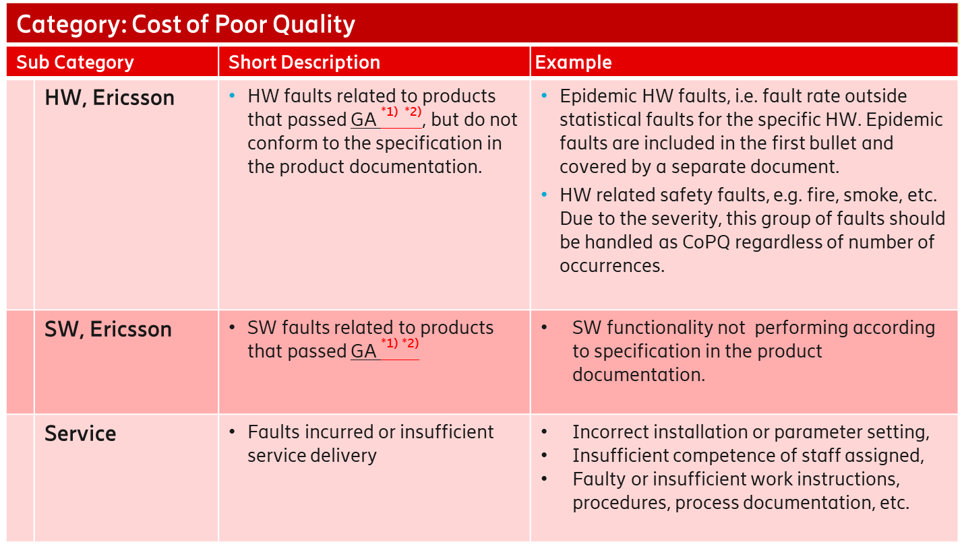
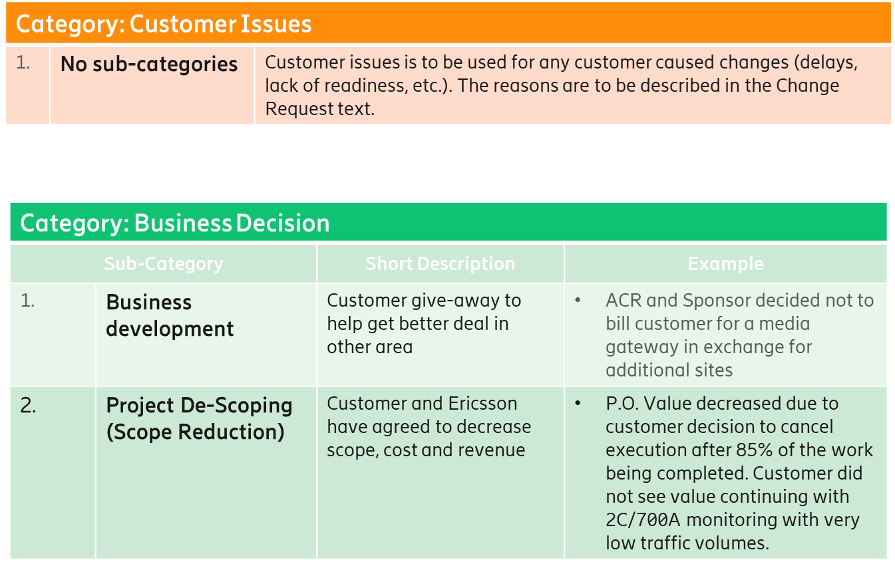
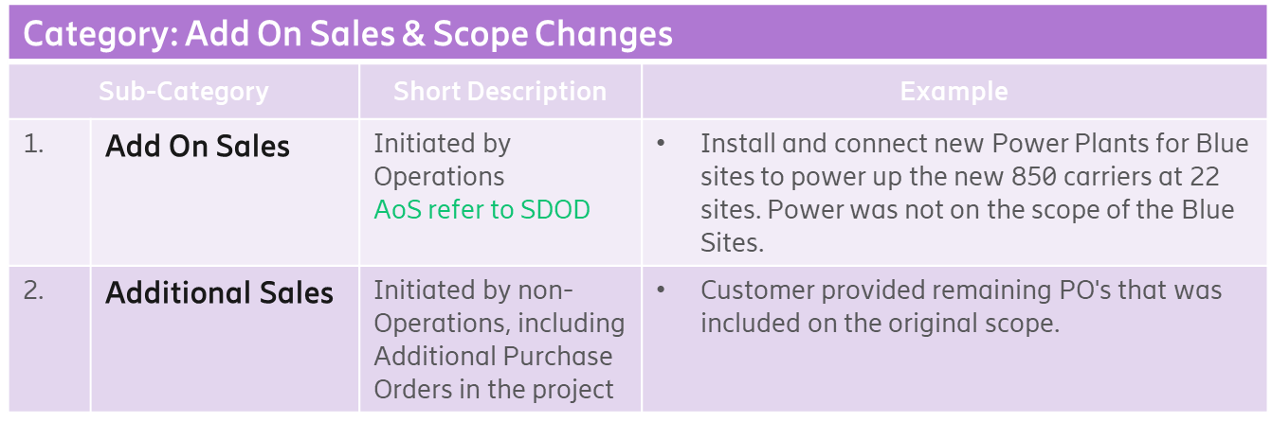
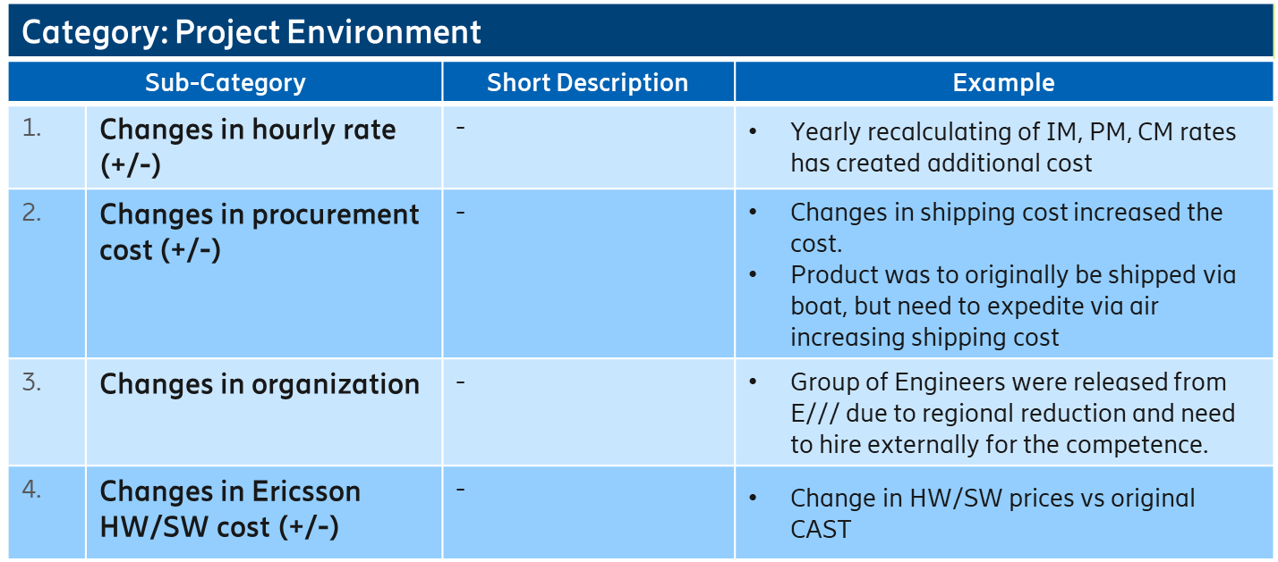
Change request
CR AoS & Status
CR Flow
CR other Category Description

Slide 13


Standard CR Flow overview Internal Ericsson
Approved By:
SMALL IMPACT CR
Project
CCB
Approved
CR
Type of
Change ?
Rejected
CR
MARGIN IMPACT CR
Implement
CR
Steering
CCB
Analyze
CR
Postpone
CR
Validate
CR
Sign-off
Customer
Supporting Tool:
Global Chronos (mandatory)
Create
CR
Invoice
Customer
Customer
Ericsson
Initiated By:

Slide 14
The Change Control Board guide
CR analysis & submission
CCB quality audit
CCB review & decisions
Propose CR to customer & negotiate
CR Final Decision

Slide 15



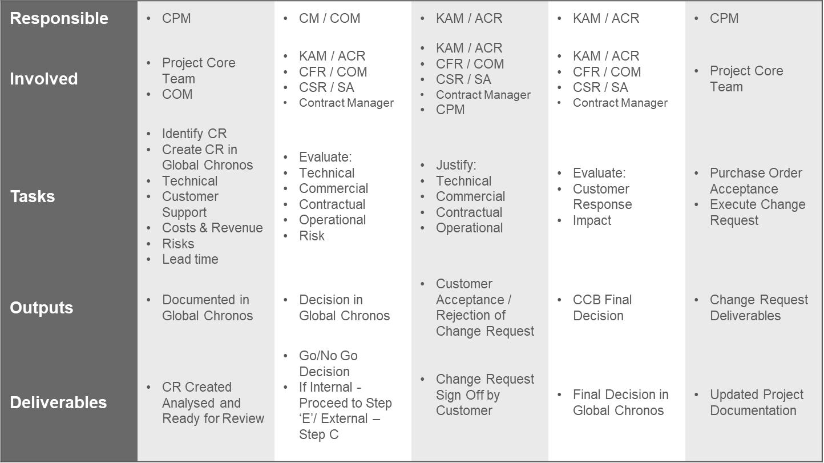
Increased Governance Change Control Board (CCB) mandatory for all projects
No changes without advance formal approval
Change Control Board
CCB is a team built on an account by account basis
It is an Ericsson internal function described as:
- a decision making board - holds regular meetings, working through a set repeatable process
- purpose is to maximize Add-on Sales though efficient processing of Change Requests
Important Links
A
B
C
D
E
CR Analysis & Submission
CCB Review & Decisions
Propose CR to Customer/Negotiate
CCB Final Decision
CR Execution
Minutes of Meeting & Checklist
For use in steps B & D.
Default template for External CRs
(to be replaced with standard contractual document if available)
For use in Step C – Propose to Customer
Risk analysis template
Provided by Business Excellence Group for strategic programs
For use in Steps B & D
Financial and Risk Analysis template

Slide 16
A
B
C
CR Analysis & Submission
CCB Review & Decisons
Propose CR to customer
Roles & responsibilities
Steps A, B & C
KAM / ACR | N/A | Define if it should be External / Internal, and Billable / Non-billable Lead in Commercial Analysis | Recommend Negotiation strategy (how do we justify) Communication approach towards the customer (level) Finalize Price in the “CR Form” submission
CFR / COM | N/A | (In absence of dedicated Contract Manager), arrange fortnightly CCB meeting and assume other responsibilities of Contract Manager. Refer the CRs raised by CPMs to the CCB Lead in Operational & Risk Analysis | Approve the “CR“ for submission from cost and scope perspective
CSR / SA | As defined in PROPS-C Support CPM in Technical Analysis (Global Chronos). | Lead in Technical Analysis | Approve the “CR“ for submission from solutions perspective
Contract Manager | Support CPM on request | Arrange fortnightly CCB meeting Lead in Contractual Analysis Update MoM & Checklist. | Approve the “CR“ for submission from T&C’s perspective
CPM | As defined in PROPS-C. Submit CRs to CCB CR Handling in Global Chronos | N/A | Can be appointed by the KAM to submit CR to the operations counterpart for customer approval
Steps D & E
Check List

Slide 17
D
E
CCB Final Decision
CR Execution
Roles & Responsibilities
Steps A, B & C
KAM / ACR | Final decision maker on approval/rejection based on customer feedback Counter sign “Change Request” form if bilateral agreement. | Send PO to Operations once received by customer for execution. Approve Updated Budget and Project Plan
CFR / COM | Validate final offer | Customer support/Managed Services Impact alignment
CSR / SA | Validate final offer | Update solution document
Contract Manager | Update Risks in “Commercial and Risk Impact” template. based on counter offer T&C feedback if customer counter offers | Necessary contract amendment update Provide on-going guidance contractually
CPM | N/A | Update Budget and Project Plan Execution of Work Order
Steps D & E
Check List

Slide 18
Quick Start Checklist before first meeting
A centralized EriDoc workgroup has been set up for MMEA Change Control Board 2019
Click on this link
MoM must be uploaded into the particular accounts folder for CCB meetings.
This workgroup offers templates, guidelines and performance reporting.
The data in the EriDoc folder is the one and only data point, when it comes to CCB meeting numbers and their validity.
It appears that some CCB meetings may be taking place but without proper MoM uploaded to this EriDoc folder. In this case it will not be reported that a CCB meeting has actually taken place. In some cases EriColl or no folders at all have been reported.
.
Choose CCB permanent members. – KAM/COM
Arrange date of first meeting and recurring meetings – KAM/COM
Carry out review as per Part A of CCB Process. Prepare relevant potential CRs and send to COM for CCB review. Raise awareness in project teams about CRs. – CPM
Roles & Responsibilities
Steps A, B & C
CCB core members:
Important to note
KAM (or account manager delegated by KAM
COM/ DS Customer Team Head
Network CTO/ DS Solution Partner
Contract Manager
MSCOO ( MS)
SDM (if CS account)
If any role is unable to attend a CCB meeting, a substitute is compulsory
Steps D & E
Check List
Meetings
Important to note
Scheduled monthly
1 hour max
MoM are recorded and stored in EriDoc
It is best to have meetings often, some meetings may be an hour max, but some may be shorter, depending on how many CRs there are

Slide 19
Recognition of AoS – Financials
3 steps to follow
One entry form – OEF is completed tag AoS
AoS tab is ticked & Responsible person match SDOD & GC.
Tagging in SAP is defined as Z_AoS
SAP
OEF
EBW
COPA
Important to note
This is compulsory step to follow to allow correct financial reporting of AoS

